Slide 1

Asset Rental Agreement & Financial Analytics
Data Science Practicum 1 , MSDS692_S40_Data Science Practicum
Prakash Ghatani | Regis University, Denver CO | pghatani@regis.edu
This asset's rental agreement analysis helps understand rental costs, contracts, vendor information, and missing data. The project also uses data analysis and machine learning to predict future monthly rental costs.

Slide 2
Business Problem & Research Questions
The company has many leased assets in different locations.
These assets are managed under different contracts, vendors, and manufacturers.
It is difficult to find expensive assets without data analysis.
It is also hard to find unusual rental costs and contract risks.
Data analysis can help find ways to reduce costs and improve lease management
Main prediction target: Asset Rental Expenses
Which vendors and manufacturers have the highest rental costs?
Which asset types generate the highest monthly rental amounts?
Are there any unusual rental amounts compared to asset costs?
Which factors best predict asset rental amounts?
How can lease costs be reduced and lease management improved?

Slide 3
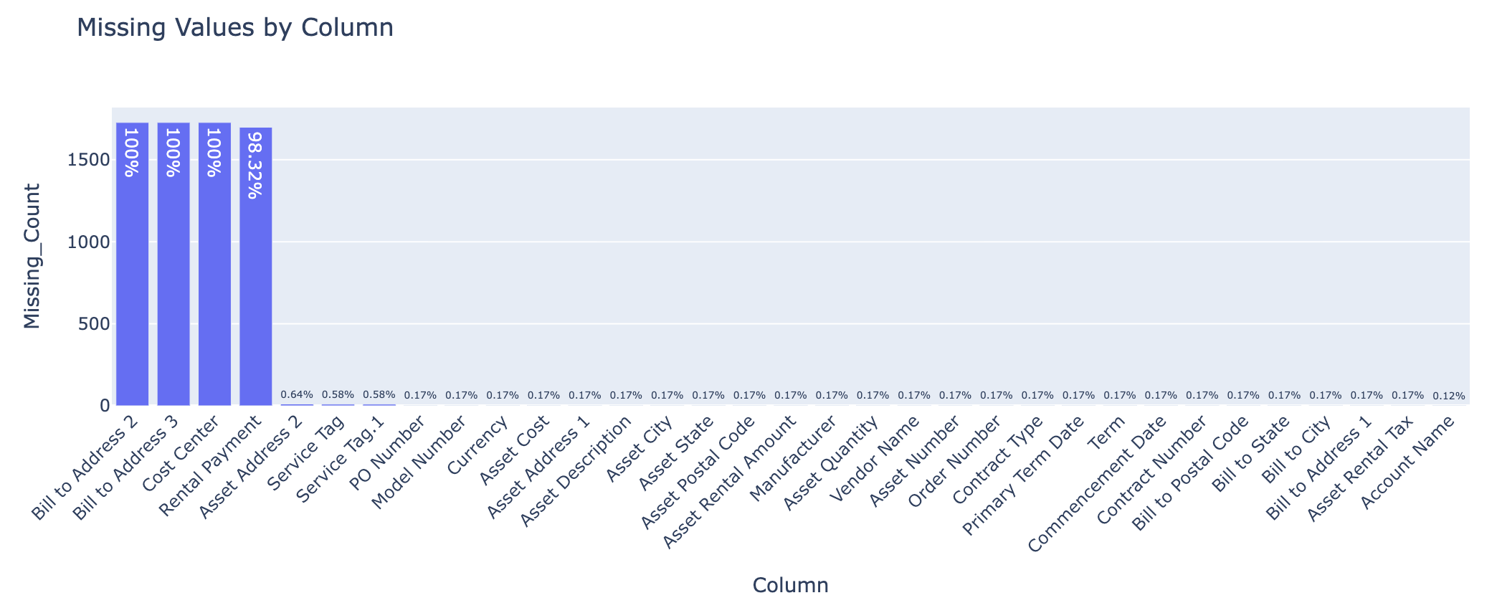
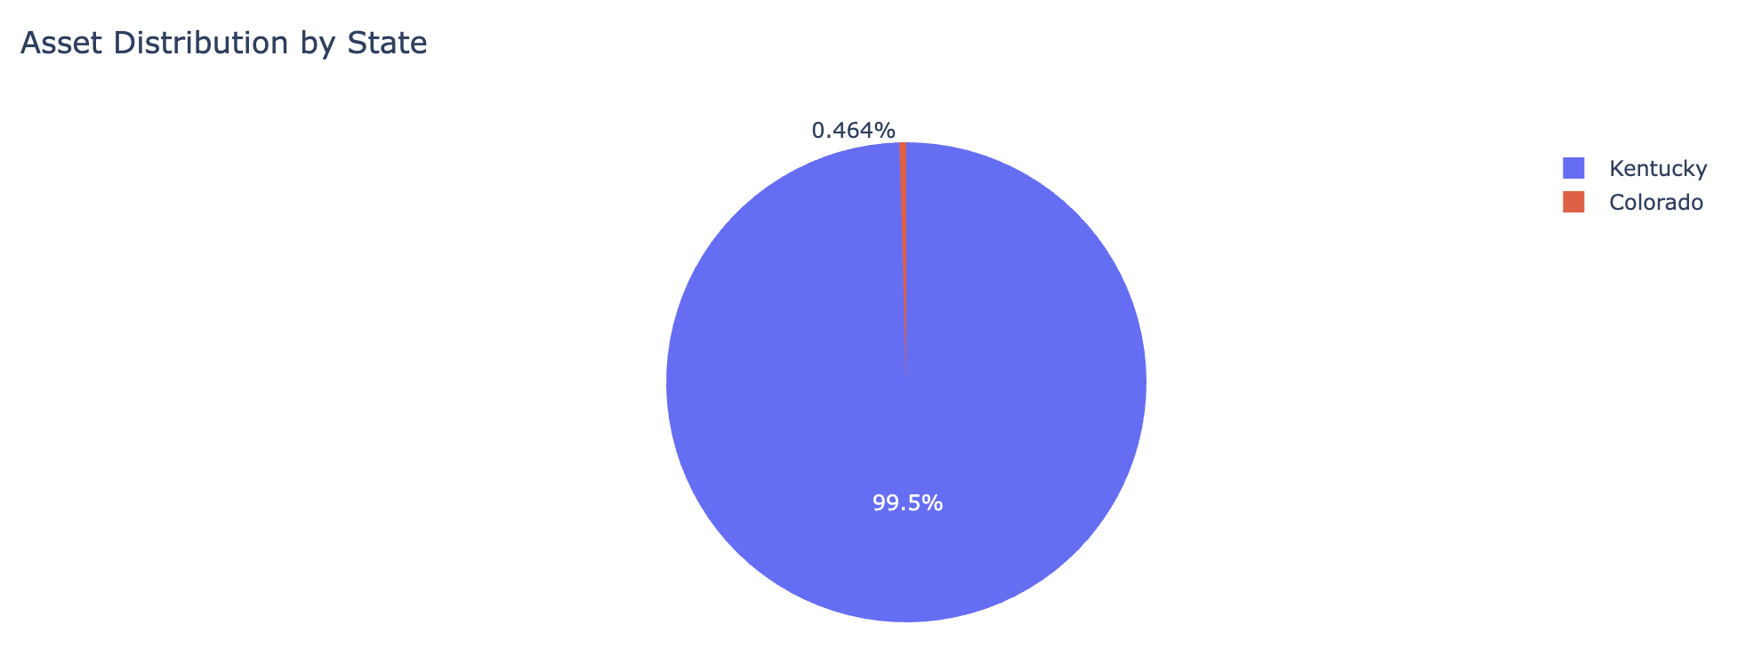
Accessing the Data and Data Analysis
Load the Excel file
Review rows, columns, data types, and missing values
Define the business goal and prediction target
Asset distribution by state
Vendor and manufacturer cost analysis
Rental amount distribution
Asset cost vs rental amount relationship
Missing data visualization

Slide 4
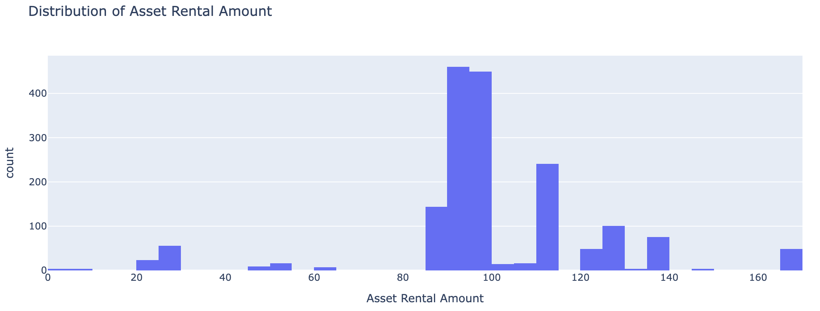
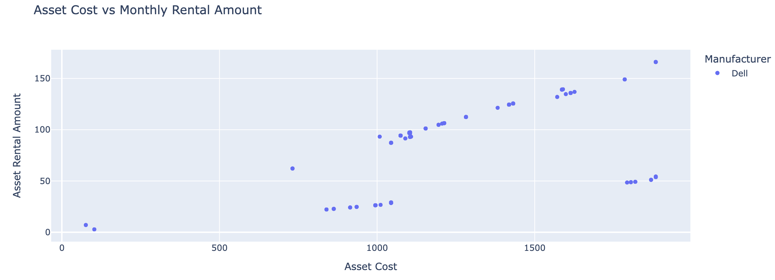
Exploratory Data Analysis (EDA)
Distribution of Asset Rental Amount
Most of time they pay between 90 dollars and 100 dollars per month for rent.
Some assets have much higher or lower rental costs.
Asset Cost vs. Monthly Rental
Things that cost a lot usually have rent to pay every month.
Some things do not work this way. The assets may need to be looked at again.

Slide 5
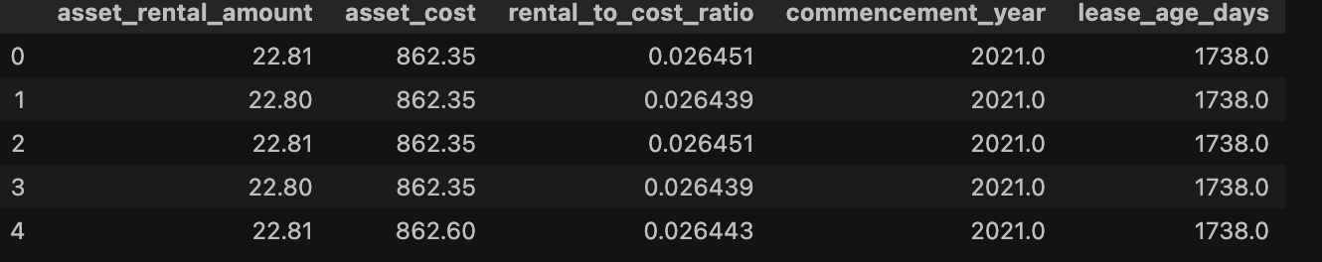
Clean column names
Handle missing values
Create useful features such as rental-to-cost ratio, lease age, and days until primary term end
Encode categorical variables
Prepare Data

Slide 6
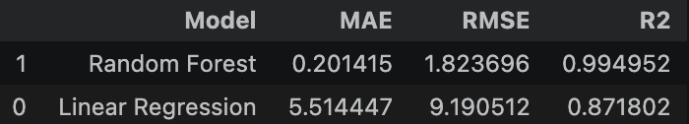
Regression Modeling
1. Linear Regression
2. Random Forest Regressor
Compare model performance using
Mean_absolute_error(MAE),
RMSE(Root Mean Squared Error),
R²(R-squared,Co-efficient of Determination)

Slide 7
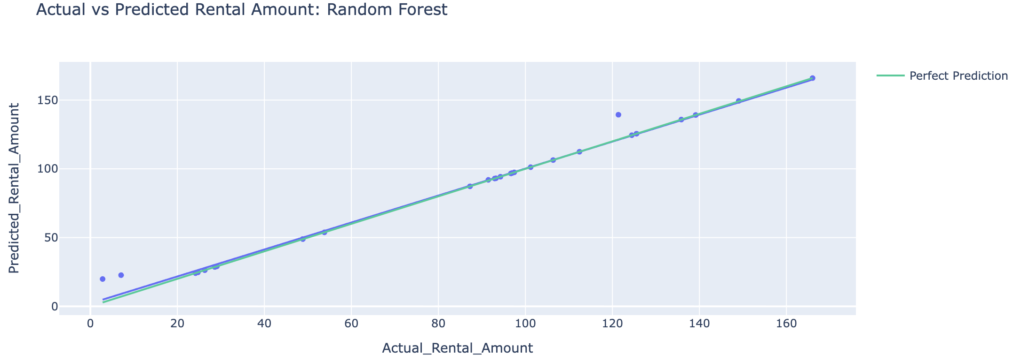
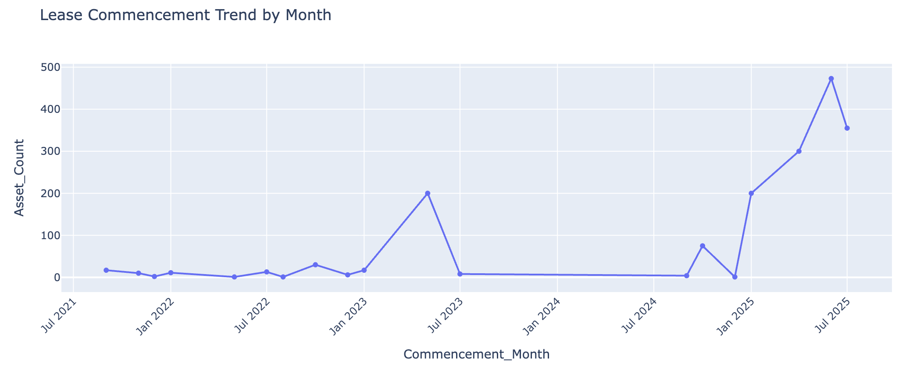
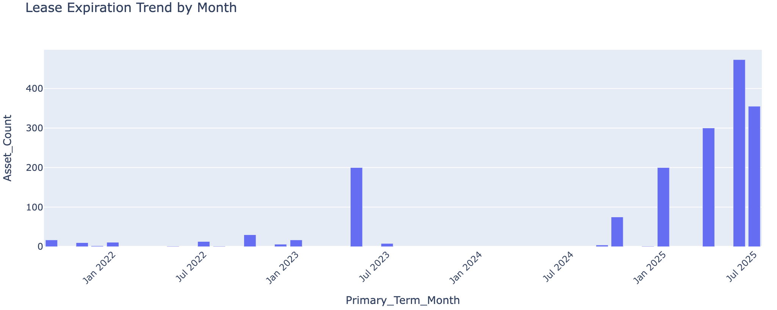
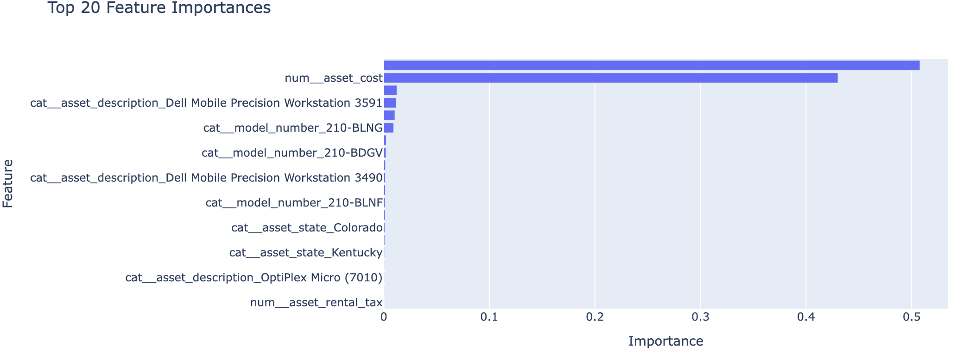
Model Evaluation and Visualization
Lease commencement trend by Month
Actual vs Predicted Rental Amount Forest
Lease Expiration Trend by Month
Top 20 Feature Importance

Slide 8
Business Recommendations
Missing Values by Column
Asset Distribution by State
Distribution of Asset Rental Amount
Asset Cost vs Monthly Rental Amount
Actual vs Predicted Rental Amount: Random Forest
Lease Commencement Trend by Month
Lease Expiration Trend by Month
Top 20 Feature Importances

Slide 9
Conclusion
Analyzed 1,727 lease assets and 29 contracts.
Performed data cleaning, exploratory data analysis (EDA), and predictive modeling.
Found a strong relationship between asset cost and monthly rental amount.
Identified missing data and pricing outliers that may require review.
The model predicted rental costs and identified the key cost drivers.
These insights support better lease planning and cost savings.

Slide 10
References
· Abdimanapova, G., Zhaidakbayeva, L., & Aldeshov, S. (2023). Graphics capabilities in Python. Avrasya Sosyal ve Ekonomi Araştırmaları Dergisi, 10(Prof. Dr. Raskul Ibragimov Özel Sayısı), 1–14. https://plotly.com/python/
· Fields, D. (2022). Automated landlord: Digital technologies and post-crisis financial accumulation. Environment and Planning A: Economy and Space, 54(1), 160–181. https://doi.org/10.1177/0308518X19846514
· Krishnan, V. S., & Moyer, R. C. (1994). Bankruptcy costs and the financial leasing decision. Financial Management, 23(2), 31–42.
· Morales-Díaz, J., & Zamora-Ramírez, C. (2018). The impact of IFRS 16 on key financial ratios: A new methodological approach. Accounting in Europe, 15(1), 105–133. https://doi.org/10.1080/17449480.2018.1433307
· Sharma, M., Ammons, J. C., & Hartman, J. C. (2007). Asset management with reverse product flows and environmental considerations. Computers & Operations Research, 34(2), 464–486. https://doi.org/10.1016/j.cor.2005.03.009
· Singh, C., Shelor, R., Jiang, J., & Klein, G. (2004). Rental software valuation in IT investment decisions. Decision Support Systems, 38(1), 115–130. https://doi.org/10.1016/S0167-9236(03)00081-2

Slide 11
Thank You

